Slide 1
Windows server 2019 實戰

Slide 2
agenda
hyper-v

Slide 3
hyper-v

Slide 4
ping

Slide 5
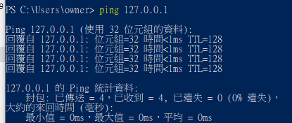
12.0.0.1

Slide 6
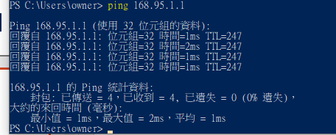
168.95.1.1

